Slide 1
ALGORITHM TIME COMPLEXITY & LOOP INVARIANT Lecture # 25

Slide 2
ALGORITHM
The word "algorithm" refers to a step-by-step method for performing some action.
OR
It’s a recipe to solve a particular problem.
A computer program is, similarly, a set of instructions that are executed step-by-step for performing some specific task.

Slide 3
INFORMATION ABOUT ALGORITHM
The name of the algorithm, together with a list of input and output variables.
The input variables names, labeled by data type.
The statements that make the body of the algorithm, with explanatory comments.
The output variable names, labeled by data type.
An end statement.

Slide 4
ANALYSIS OF ALGORITHM
Efficiency of an algorithm can be measured in terms of:
Execution time (time complexity)
The amount of memory required (space complexity)

Slide 5
TIME COMPLEXITY
The time complexity of an algorithm can be expressed in terms of number of operations used by an algorithm when the input has a particular size.
Time complexity is described in terms of number of operations required instead of actual computer time.

Slide 6
SPACE COMPLEXITY
An analysis of computer memory required involves the space complexity of an algorithm.
Considerations of space complexity are tied in with the particular data structures used to implement the algorithm.
We will restrict our attention to time complexity.

Slide 7
MEASURING TIME COMPLEXITY
Counting number of operations involved in the algorithms to handle n items.
Objectives of time complexity analysis:
To determine the feasibility of an algorithm by estimating an upper bound on the amount of work performed.
To compare different algorithms before deciding on which one to implement.

Slide 8
To simplify analysis, we sometimes ignore work that takes a constant amount of time, independent of the problem input size
When comparing two algorithms that perform the same task, we often just concentrate on the differences between algorithms.
Big-O notation is used to measure the time complexity.
To deal with n items, time complexity can be O(1), O(log n), O(n), O(n log n), O(n²), O(n³), O(2^{n}), even O(n^{n}).

Slide 9
Simplified analysis can be based on:
Number of arithmetic operations performed
Number of comparisons made
Number of times through a critical loop
Number of array elements accessed
etc

Slide 10
EXAMPLE: POLYNOMIAL EVALUATION
Suppose that exponentiation is carried out using multiplications.
p(x) = 4x⁴ + 7x³ – 2x² + 3x + 6
are:
P(x) = 4*x*x*x*x + 7*x*x*x – 2*x*x +3*x + 6
Method of Analysis:
Basic operations are multiplication, addition, and subtraction

Slide 11
We’ll only consider the number of multiplications, since the number of additions and subtractions are the same in each solution.
We’ll examine the general form of a polynomial of degree n, and express our result in terms of n.
We’ll look at the worst case (max number of multiplications) to get an upper bound on the work

Slide 12
GENERAL FORM OF POLYNOMIAL
General form of polynomial is:
p(x) = a_{n}x^{n} + a_{n-1}x^{n-1} + a_{n-2}x^{n-2} + … + a₁x¹ + a⁰
where a_{n} is non-zero for all n >= 0

Slide 13
Analysis:
p(x) = a_{n} * x * x * … * x * x + n multiplications
a_{n-1} * x * x * … * x * x + n-1 multiplications
a_{n-2} * x * x * … * x * x + n-2 multiplications
… + …
a₂ * x * x + 2 multiplications
a₁ * x + 1 multiplication
a₀
Number of multiplications needed in the worst case is
T(n) = n + n-1 + n-2 + … + 3 + 2 + 1
= n(n + 1)/2
= n²/2 + n/2

Slide 14
BIG – O Notation
Formally, the time complexity T(n) of an algorithm is O(f(n)) (of the order f(n))
Example:
Q: What is the Big-O notation for polynomial evaluation?
We chose the highest-order term of the expression:
T(n) = n²/2 + n/2 ,
so, T(n) is O(n²)

Slide 15
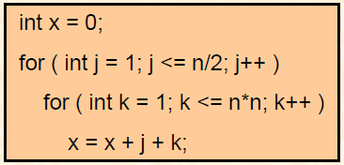
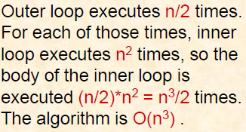
BIG – O Analysis in General
With independent nested loops: The number of iterations of the inner loop is independent of the number of iterations of the outer loop.
Example:

Slide 16
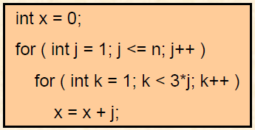
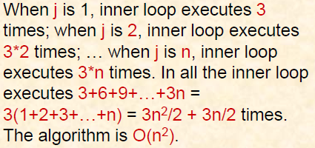
BIG – O Analysis in General
With dependent nested loops: The number of iterations of the inner loop is depends on the value from the outer loop.
Example:

Slide 17
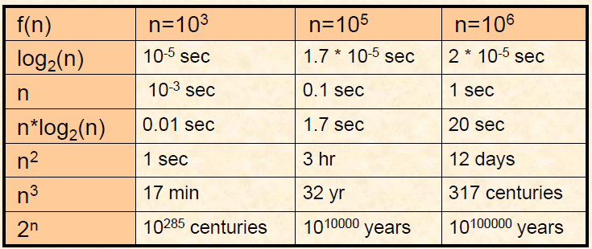
BIG – O Analysis in General
Assume that a computer executes a million instructions a second. This chart summarizes the amount of time required to execute f(n) instructions on this machine for various values of n.

Slide 18
To determine the time complexity of an algorithm:
Express the amount of work done as a sum:
f₁(n) + f₂(n) + … + f_{k}(n)
Identify the dominant term: the f_{i} such that f_{j} is O(f_{i}) and for k different from j
f_{k}(n) < f_{j}(n) (for all sufficiently large n)
Then the time complexity is O(f_{j})

Slide 19
INTRACTABLE PROBLEM
A problem is said to be intractable if solving it by computer is impractical.
Example:
Algorithms with time complexity O(2^{n}) take too long to solve even for moderate values of n; a machine that executes 100 million instructions per second can execute 2⁶⁰ instructions in about 365 years.

Slide 20
CONSTANT TIME: O (1)
An algorithm is said to run in constant time if it requires the same amount of time regardless of the input size.
Constant time complexity is denoted as O(1).

Slide 21
LINEAR TIME: O (n)
An algorithm is said to run in linear time if its time execution is directly proportional to the input size, i.e. time grows linearly as input size increases.
Linear time complexity is denoted as O(n).
Examples:
Array: linear search, traversing, find minimum

Slide 22
LOGARITHMIC TIME: O (log n)
An algorithm is said to run in logarithmic time if its time execution is proportional to the logarithm of the input size.
Example:
binary search

Slide 23
QUADRATIC TIME: O (n²)
An algorithm is said to run in quadratic time if its time execution is proportional to the square of the input size.
Examples:
bubble sort, selection sort, insertion sort

Slide 24
EXAMPLE
Calculate the time complexity of the algorithm.
Main()
{
int a, b, c, d, i;
for (i=0, i<=9, i++)
{
a = a + b;
b = b + 1;
}
d = c + d;
}
T() = 1 + 11 + 10 +10 + 1
T() = O(11) = O(1)
1
11
10
10
1

Slide 25
EXAMPLE
Calculate the time complexity of the algorithm.
Main()
{
int i, j, k, n;
i = i + 1;
for (i=1, i<=n, i++)
{
j = j + 1;
}
k = k + 1;
}
T() = 1 + 1 + n + 1 + n + 1 = 2n + 4
T() = O(n)
1
1
n + 1
n
1

Slide 26
EXAMPLE
Describe the time complexity of an algorithm.
for ( i=0 ; i<n ; i++ )
for( j=0 ; j<n ; j++ )
sum[i] += entry[i][j];
T() = O(n²)
n + 1
Inner Loop:
I() = 2n + 1
Outer Loop:
J() = n + 1
Total time:
T() = I().J() = (2n+1)(n+1)
= 2n² + 3n + 1
n + 1
n

Slide 27
EXAMPLE
Calculate the time complexity of the algorithm.
Main()
{
int i, j, a, b;
for (i=1, i<=n, i++)
{
for (j=1, j<=n, j++)
{
a = a + 1;
}
k = k + 1;
}
}
T() = O(n² )
Inner Loop:
I() = 2n + 1
Outer Loop:
J() = 2n + 1
Total time:
T() = I().J() = (2n+1)(2n+1)+1
= 4n² + 4n + 2 + 1
= 4n² + 4n + 3
1
n + 1
n + 1
n
n

Slide 28
EXAMPLE
Describe the time complexity of an algorithm.
for( i=0 ; i < n ; i++)
m += i;
It takes 2n + 1 operations. The time complexity of this algorithm is O(n).
n + 1
n

Slide 29
EXAMPLE
Describe the time complexity of an algorithm.
for ( i=1 ; i<n ; i++ )
for( j=0 ; j<i ; j++ )
m += j;
when i = 1, the inner loop executes 1 times, when i = 2, the inner loop executes 2 times, … when i = n, the inner loop executes n times. In all the inner loop executes:
1 + 2 + 3 + ... + n = n(n+1)/2 = n²/2 + n/2
So, T() = O(n²)

Slide 30
EXAMPLE
Describe the time complexity of an algorithm.
for ( i=0 ; i<n ; i++ )
for( j=0 ; j<n ; j++ )
for( k=0 ; k<n ; k++ )
sum[i][j] += entry[i][j][k];
T() = O(n³ )
Inner Loop:
I() = 2n + 1
Middle Loop:
M() = n + 1
Outer Loop:
J() = n + 1
Total Time:
T() = I().M(). J()
= (2n+1)(n+1)(n+1)
= 2n³+5n²+4n+1
n + 1
n + 1
n + 1
n

Slide 31
EXAMPLE
Describe the time complexity of algorithm for finding the maximum element in a finite set of integers.
int maximum(int B[ ],int n)
{
int max = B[0];
for(int j=0; j<n; j++)
{
if(B[j] > max)
max = [j];
}
return max;
}
1
n + 1
n
n
1
It takes 3n + 3 operations. Time complexity is O(n)

Slide 32
EXAMPLE
Describe the time complexity of linear search algorithm.
int search(int B[ ], int size, int value)
{
for(int j=0; j<size; j++)
{
if(B[j] = = value)
return 1;
}
return 0;
}
n + 1
n
1
1
It takes 2n + 3 operations. Time complexity is O(n).

Slide 33
BINARY SEARCH ALGORITHM
found = false; low = 0; high = N – 1;
while (( ! found) && ( low <= high))
{
mid = (low + high)/2;
if (A[mid] = = key)
found = true;
else
if (A[mid] > key)
high = mid – 1;
else
low = mid + 1;
}

Slide 34
found = false; low = 0; high = N – 1;
while (( ! found) && ( low <= high))
{
mid = (low + high)/2;
if (A[mid] = = key) found = true;
else if (A[mid] > key) high = mid – 1;
else low = mid + 1;
}
0
0
0
1
2
3
4
5
6
7
7
7
8
8
9
9
10
10
11
11
11
12
13
14
15
15
15
2
3
5
7
10
12
15
22
28
29
29
32
47
48
50
55
73
key = 29
Average number of comparisons ?
Order of “log(N)” as compared to N.

Slide 35
Performance Comparison
NADRA database: ~80,000,000 records
Computer which can perform 10,000 comparisons per second
Linear search: ~2.22 hours
Binary search: ~0.005 seconds
Roughly 1.6 million times less

Slide 36
EXAMPLE
Describe the time complexity of following algorithm.
grandTotal=0;
for(k=0; k<n-1; ++k)
{
rows[k]=0;
for(j = 0; j<n-1; ++j)
{
rows[k]=rows[k]+matrix[k][j];
grandTotal=grandTotal+matrix[k][j];
}
}
Inner Loop:
I() = 3n – 2
Outer Loop:
J() = 2n – 1
Total Time:
T() = I() . J()
= (3n – 2)(2n – 1)+1
= 6n² – 7n + 3
1
n – 1 + 1
n – 1
n – 1 + 1
n – 1
n – 1
O(n²))

Slide 37
EXAMPLE (SUMMING THE LIST OF TWO NUMBERS)
1
int main()
{
int size=10;
int a[size];
for (int n =0; n < size; n++)
{
cin >> a[n];
}
int sum = 0;
for (int i=0; i<size; i++)
{
sum = sum + a[i];
}
cout << sum << endl;
return 0;
} It takes 3n + 8 operations. The time complexity is O(n).
1
1
n + 1
n
1
n + 1
n
1
1

Slide 38
EXAMPLE
int search_min(int list[],int from, int to)
{
int i; int min= from;
for (i=from; i<=to; i++)
If (list[i] < list[min])
min = i;
return min;
}
O(n)

Slide 39
EXAMPLE
void swap(int &a, int &b)
{
int temp=a;
a = b;
b = temp;
}
O(1)

Slide 40
EXAMPLE
int main()
{ int i,j,k;
for(k=1;k<=n;k++)
{
for(i=k;i<=n-2;i++)
cout<<"*";
for(j=2;j<=k;j++)
cout<<" ";
for(j=2;j<=k;j++)
cout<<" ";
for(i=k;i<=n-2;i++)
cout<<"*";
cout<<endl;
}
}
O(n²))

Slide 41
EXAMPLE
for (int i=1; i<=n; i++)
{ int sum = 0;
if (i != n)
{
for (j=1; j<=n; j++)
{
cin>>num;
cout<<num<< " ";
sum =sum+num;
}
cout <<"sum = “<<sum<<endl;
}
}
O(n²))

Slide 42
Big Oh (O)
O (1) - constant
O (log n) - logarithmic
O (n) - linear
O (n log n) - log linear
O (n²) - quadratic
O (n³) - cubic
O (2^{n}) - exponential

Slide 43
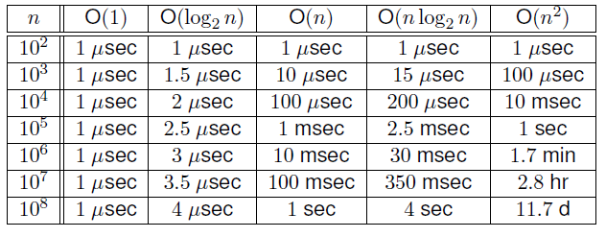
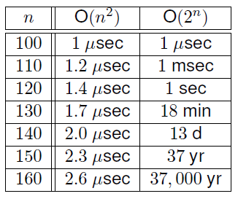
COMPARE RUNNING TIME GROWTH RATES

Slide 44
EFFICIENCY OF ALGORITHMS
Summary: count the number of instructions ignoring constants order of magnitudes
O(1) << O(log n) << O(n) << O(n²)
We cannot compare two algorithms in the same class
But we know that a running time of O(n) is faster than O(n²), for large enough values of n.
If algorithm1 has a worst-case efficiency of O(n) and algorithm2 has a worst-case efficiency of O(n²), then algorithm1 is faster (more efficient) in the worst-case

Slide 45
LOOP INVARIANT
Loop invariant is method to proof the correctness of while loops. Develop a rule of inference for program segments of the type
S is repeatedly executed until condition becomes false.
An assertion that remains true each time S is executed must be chosen. Such an assertion is called Loop Invariant.
while condition
S

Slide 46
Loop body S executed as long as loop condition holds.
Loop invariant is a condition that is necessarily true immediately before and immediately after each iteration of a loop.

Slide 47
THEOREM
Let a loop with guard G be given, together with pre- and post conditions that are predicates in the algorithm variables.
Also let a predicate I(n), called the loop invariant, be given.
If the following four properties are true, then the loop is correct with respect to its pre- and post-conditions.

Slide 48
I. Basis Property:
The pre-condition for the loop implies that I(0) is true before the first iteration of the loop.
II. Inductive property:
If the guard G and the loop invariant I(k) are both true for an integer k ≥ 0 before an iteration of the loop, then I(k + 1) is true after iteration of the loop.

Slide 49
III. Eventual Falsity of Guard:
After a finite number of iterations of the loop, the guard
becomes false.
IV. Correctness of the Post-Condition:
If N is the least number of iterations after which G is
false and I(N) is true, then the values of the algorithm
variables will be as specified in the post-condition of the
loop.

Slide 50
EXAMPLE
A loop invariant is needed to verify that the program segment.
int i = 1;
int factorial = 1;
while (i < n)
{
i = i + 1
factorial = factorial· i
}

Slide 51
SOLUTION
Let the loop invariant be:
p : “factorial = i! and i ≤ n”
Suppose n = 5 factorial we want to find
Basis Property:
At i = 1
p : “factorial = 1! and 1 ≤ 5”
Which are preconditions. Hence already satisfied.
Which is true before the first iteration of the loop.

Slide 52
Inductive property:
we are assuming that
i = k
p : “factorial = k! and k ≤ n”
we have to show that after execution of loop.
i = k + 1
p : “factorial = (k+1)! and k+1 ≤ n”

Slide 53
Before execution of statement 1.
i_{old} = k
Thus the execution of statement 1 has the following effect:
i_{new} = i_{old} + 1
= k + 1
Similarly, before statement 2 is executed,
factorial_{old} = k!

Slide 54
So after execution of statement 2,
factorial_{new} = factorial_{old}· i_{new}
= k!· (k+1)
= (k+1)k!
= (k+1)!
Hence after the loop iteration, the loop invariant is true for i = k +1.
This is what we needed to show.

Slide 55
EXAMPLE
A loop invariant is needed to verify that the program segment.
int power = 1;
int i = 1;
while (i ≤ n)
{
power = power· x
i = i + 1
}

Slide 56
SOLUTION
Let the loop invariant be:
p : i ≤ n + 1 and power = x^{i-1}

